Slide 1
Data Input
PrintNet T
Notes:
Sample Database file
./SAMPLEDATA/Fixed_Length.prn
./SAMPLEDATA/CSV.csv
./SAMPLEDATA/DBF.dbf
./SAMPLEDATA/CustCode.txt
Sample WFD file
./SAMPLEWFD/Fixed_Length.wfd
./SAMPLEWFD/CSV_Input.wfd
./SAMPLEWFD/DBF_Input.wfd
./SAMPLEWFD/CustCode.wfd
Video file
./SAMPLEVIDEO/Data_Input.avi

Slide 2
Agenda
Data Inputs
CSV
Fixed Length
Multiple Record
DBF

Slide 3

1. Data Inputs

Slide 4

Data Input
Define data structure that will be used later for layout design.
Module list
  Data Input
  ODBC Data Input
  Internal Data Input
  Script Data Input
  XML Data Input
  Parameter Data Input
  External Input
  SAP Data Input
Notes:
There are many different types of Data Input modules, but in this presentation we will just concern ourselves with the basic “Data Input”.

Slide 5
Context Schema
Workflow
Data Input
&
Manipulation
Document
Design
(Layout)‏
Impositioning
Approval (Proof)‏
Spool Production
Notes:
Data Input modules allow you to define the data structure that will be used later for layout design.

Slide 6
Data Input
Data Types supported by Data Input Module
  CSV
  Fixed Length
  DBF
  CustCode

Slide 7
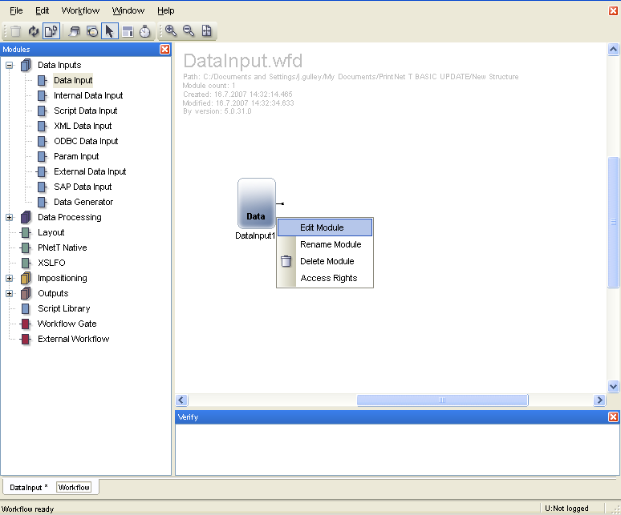
Data Input
1. Click on Data Input
module in Module Tree
2. Drag and drop
into Workflow Area
3. Double-click on the module to enter property dialog, or choose “Edit Module” submenu after right-clicking on the module.

Slide 8
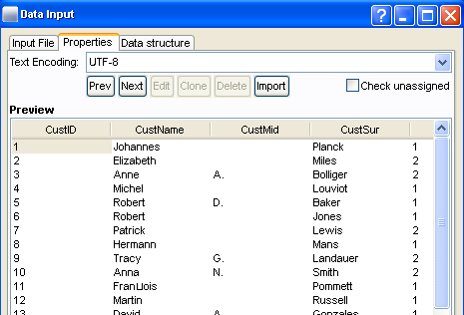
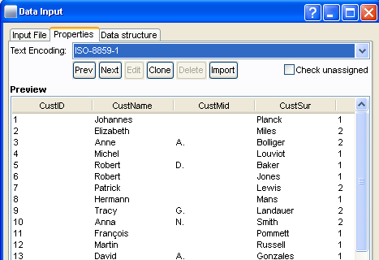
Text Encoding – Overview
All data files must have the proper text encoding set.
Text encoding is a protocol for recognizing many different text characters.

Slide 9
2. CSV

Slide 10

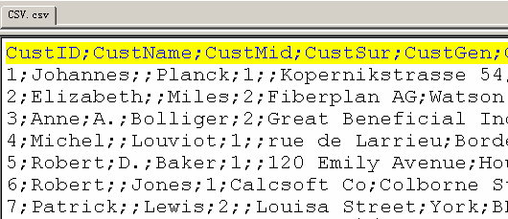
CSV – Data File Example
  CSV (Comma Separate Value) format file
  Data file preview in UltraEdit
Notes:
Variable Fields Definition on the first line.
Field Separator (Semicolon).

Slide 11
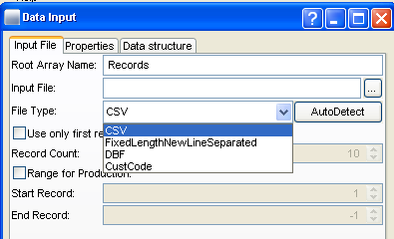
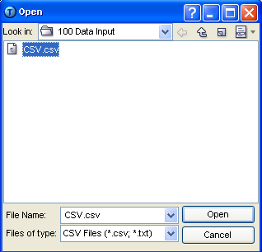
CSV – Input File Tab
Notes:
Use browse button to search for input file.
Combo-box to select appropriate input type.
Limit amount of records shown in proof to increase proof speed.
Range of records for production, is also changeable in Production interface.

Slide 12
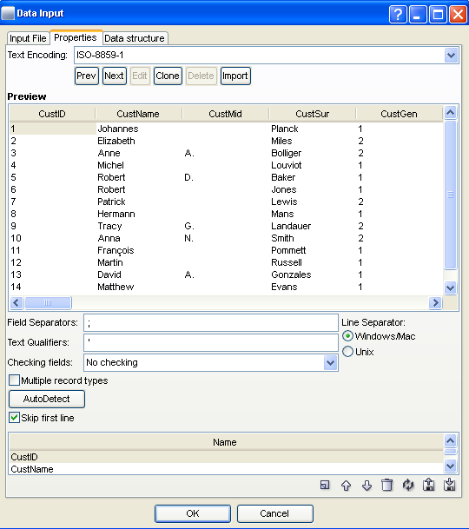
CSV – Properties Tab
Notes:
Choose proper encoding type.
Records preview in this area.
Use first line as field definition.
Variable fields definition for the specified data file.

Slide 13
CSV – Properties Tab
Notes:
Character used as a fields delimiter.
Text qualifier character.
Multiple types of data rows within one record.
Indicates whether the field separator is either for Mac/Windows or UNIX.
Rename variable fields; create new variable fields; refresh original names; change order of variable fields.

Slide 14
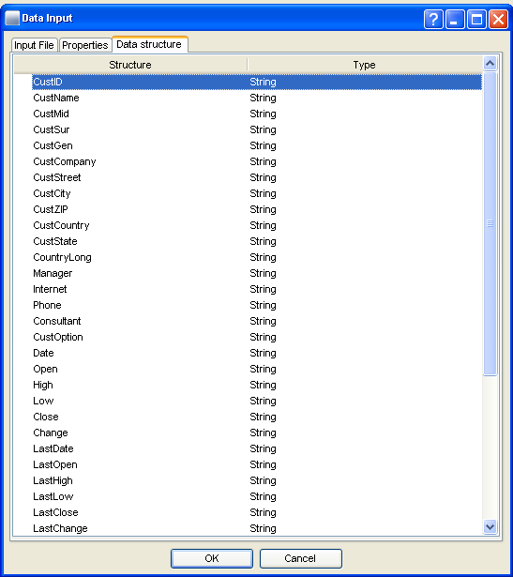
CSV – Data Structure Tab
Notes:
Breakdown for data field structure and type.

Slide 15
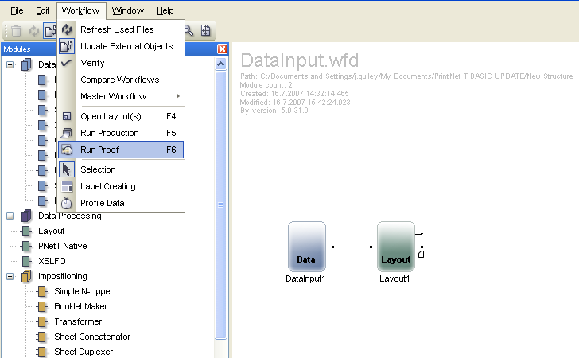
CSV – Data Proof
Notes:
Drag and drop a Layout module into the PrintNet T work space and connect it to the Data Input module.
Select Workflow|Run Proof or press <F6>.

Slide 16
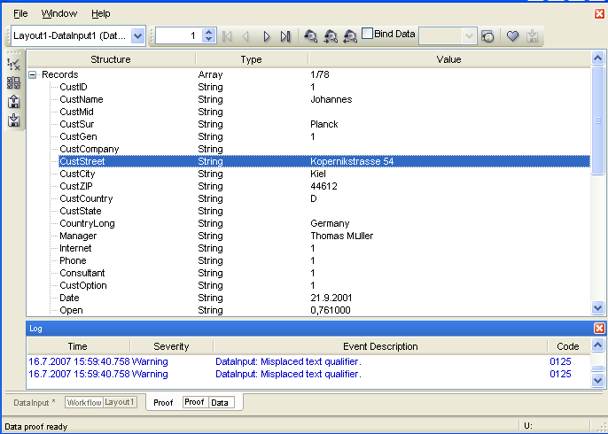
CSV – Data Proof

Slide 17

CSV – Exercise
Use a .CSV file as a Data Input.
  Create a new workflow.
  Place a Data Input and Layout module into the workflow.
  Open Data Input.
  Load CSV.csv as the Input file (from the Data Input directory).
  Set all options correctly (text qualifiers, text encoding, etc.).
  Proof the job <F6>; use Data Proof to see data structure.

Slide 18
3. Fixed Length

Slide 19
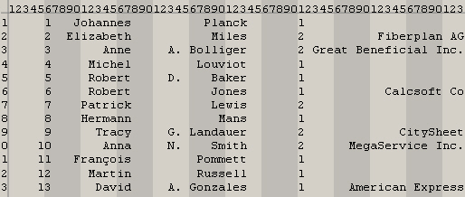
Fixed Length – Data File Example
Fixed length – Padded with spaces
Data file preview
Notes:
Padded with spaces to keep fixed size

Slide 20
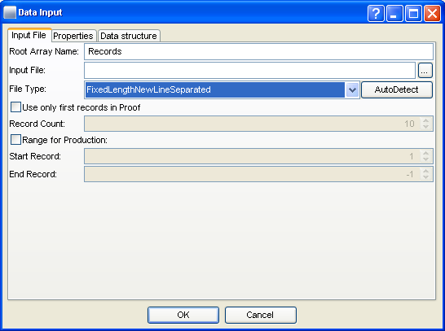
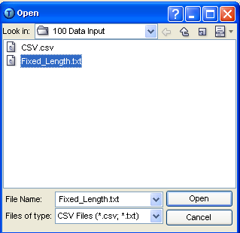
Fixed Length – Input File Tab
Notes:
Click here to browse for a fixed length data file.
Select a fixed length file as “Input file”.

Slide 21
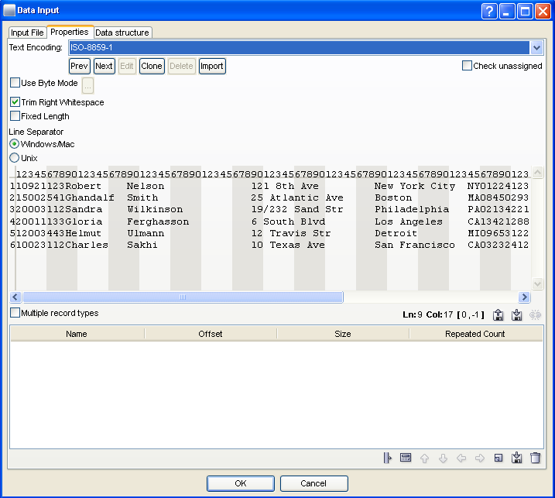
Fixed Length – Properties Tab
Notes:
Leave it checked for mixed bytes.
Leave it unchecked to leave the right white spaces.
Leave it checked for fixed record length.
Records preview in this area.
New variable fields will be created here.

Slide 22
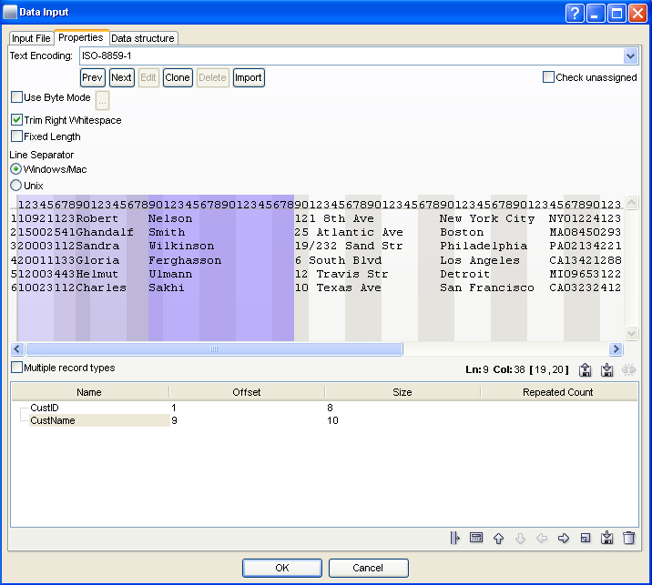
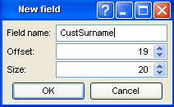
Fixed Length – Key Field Definition
Notes:
Highlight relative information- start/end position with mouse.
New field is added here with selected information.
Click Create New icon to create new variable.

Slide 23
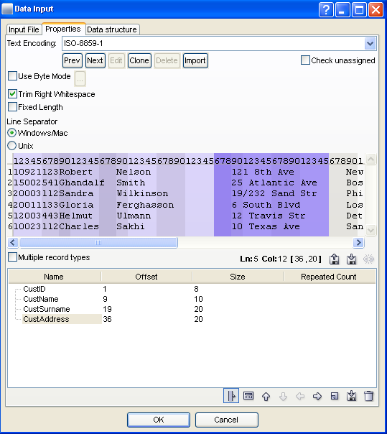
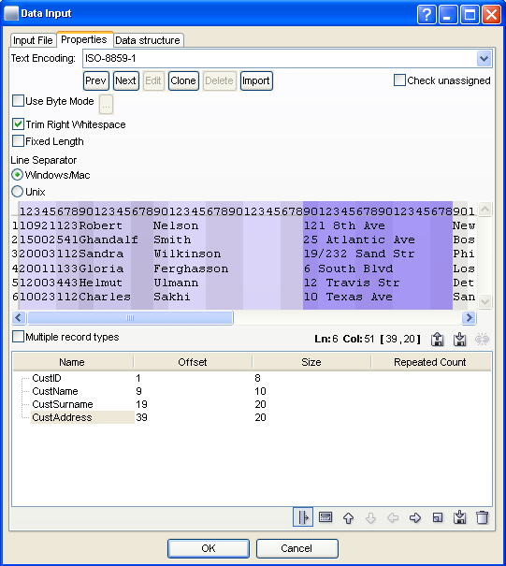
Fixed Length – Key Field Definition
Recalculate offsets intuitively:
Notes:
If you enter a data field incorrectly, you can select the “Edit fields by mouse” icon, and then click on the field you want to edit before dragging the field to its proper placement.

Slide 24
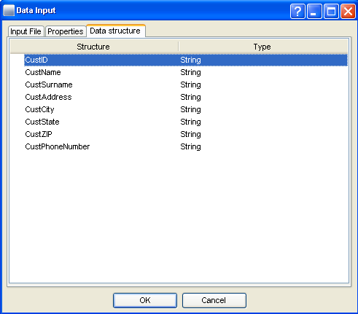
Fixed Length – Data Structure Tab
Notes:
Breakdown for data field structure and type

Slide 25
Fixed Length – Data Proof
Notes:
Drag and drop a Layout module into the PrintNet T work space and connect it to the Data Input module.
Select Workflow|Run Proof or press <F6>.

Slide 26
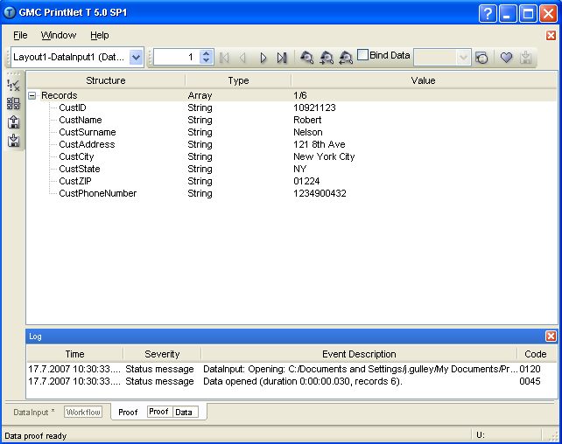
Fixed Length – Data Proof

Slide 27
Fixed Length – Exercise
Use a .TXT file as a Fixed Length Data Input.
  Create a new workflow.
  Place a Data Input and Layout module into the workflow.
  Open Data Input.
  Load Fixed_Length.txt as the Input file (from the Data Input directory).
  Set all options correctly (text qualifiers, text encoding, etc.).
  Set the data fields according to the fixed length for the following categories: ID, Name, Surname, Address, City, State.
  Proof the job; use Data Proof to see data structure.

Slide 28
4. Multiple Record

Slide 29
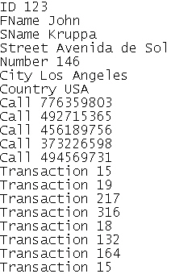
Multiple Record – Data File Example
Key Fields
Data Values
Notes:
Key Fields are the first item on each line. They have different lengths; therefore, the Data Values begin and end at different lengths.

Slide 30
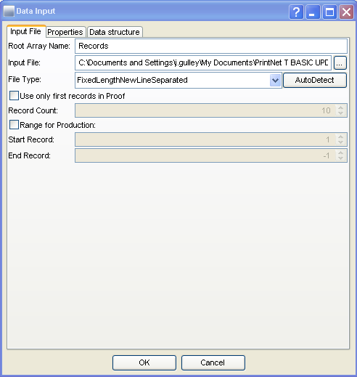
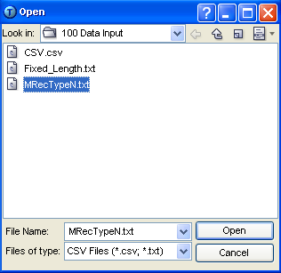
Multiple Record – Input File Tab
Notes:
For Multiple Record type data files, you must select FixedLengthNewLineSeparated in the File Type combo-box.

Slide 31
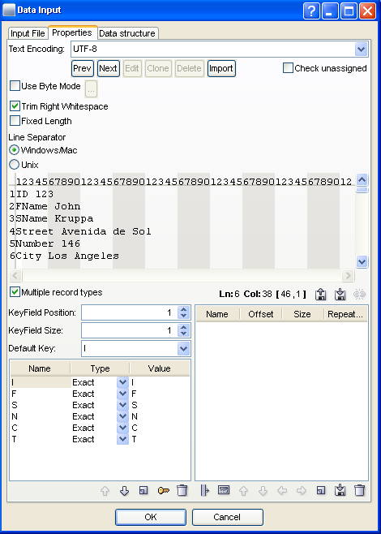
Multiple Record – Key Field Definition
Records preview in this area
KeyField
KeyField Definition
Multiple Record Types must be checked

Slide 32
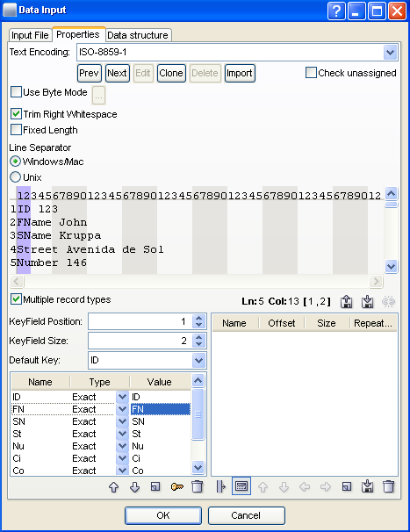
Multiple Record – Default Field
Default fields indicates where records will be separated
ID is the default field
Notes:
In this example, ID is the default field; every new record in the job will be recognized by, and begin with, ID.

Slide 33
Multiple Record – Default Field
To set the default field:
  Click and drag your cursor the length of the first field
  Click on the key icon at the bottom of the dialog
Notes:
In this example, ID is the default field; every new record in the job will be recognized by, and begin with, ID.
To set the default field:
Click and drag your cursor the length of the first field
Click on the key icon at the bottom of the dialog

Slide 34
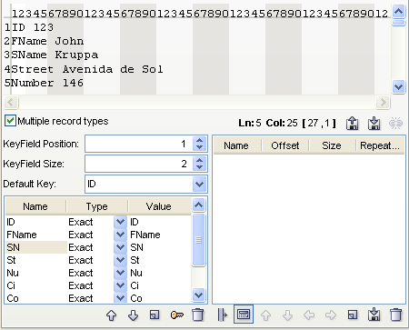
Multiple Record – Naming Fields
Subsequent fields do not need to be the same length as the key field.
Click on other fields and press <F2> to rename them.
How your field will appear in the data structure
The value of the field as it appears in the data file
Notes:
Usually you wouldn’t have to rename your fields, but it makes it easier for you and any other users of the job. “FName” is more easily recognizable than “FN”, “Call” is more easily recognizable than “Ca”, etc. Occasionally it might happen that data files with very small key fields (e.g., “ID”) will also have other fields with similar beginnings, such as “Country” and “County”. In this case, these two fields would have to be renamed at the very least. It is recommended to rename all your fields regardless of whether or not there is duplication in field definition.
Rename your fields with <F2>. The value field must appear exactly as it does in the data file, or shorter, but it cannot be longer. For example, Transaction could be named “Transaction”, “Trans”, “Transact”, etc., but it could not be named “Transactions”.

Slide 35
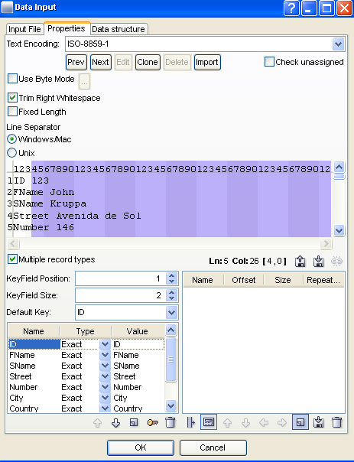
Multiple Record – Setting Variables
Apply variables to fields.
Click and drag to set the value length of the variable; click on Create New Variable icon.
Select field length for ID
Make sure ID field is selected
Click Create New Variable
Notes:
Once your fields are set, you can apply variables to them.
Click and drag to set the value length of the variable; click on Create New Variable icon.

Slide 36
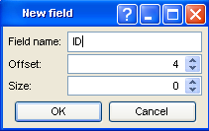
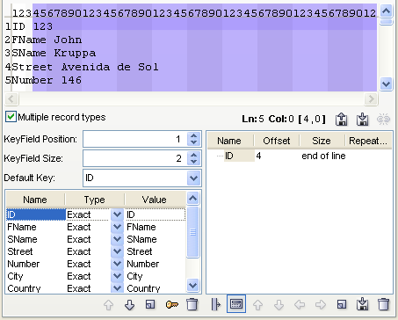
Multiple Record – Setting Variables
Name your variable and click “OK”
Variable appears in second column

Slide 37
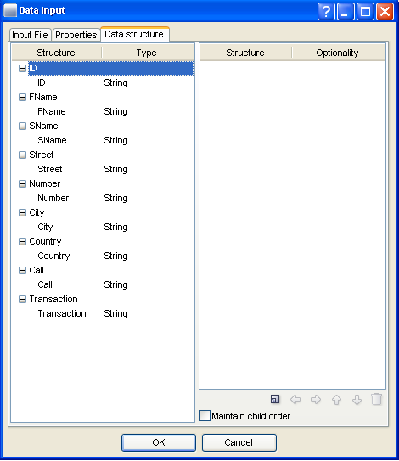
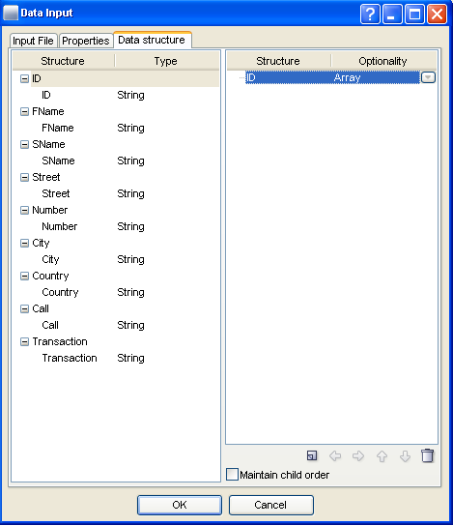
Multiple Record – Data Structure
Once all fields and variables are set, data structure must be defined.
Click on data fields and add to structure
Variable appears in data structure

Slide 38
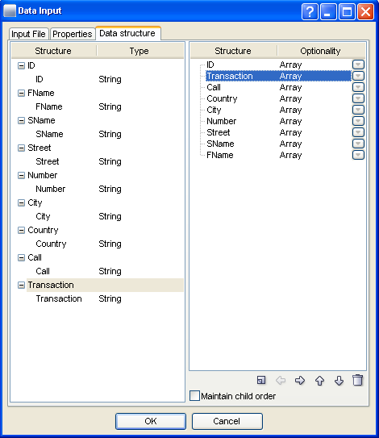
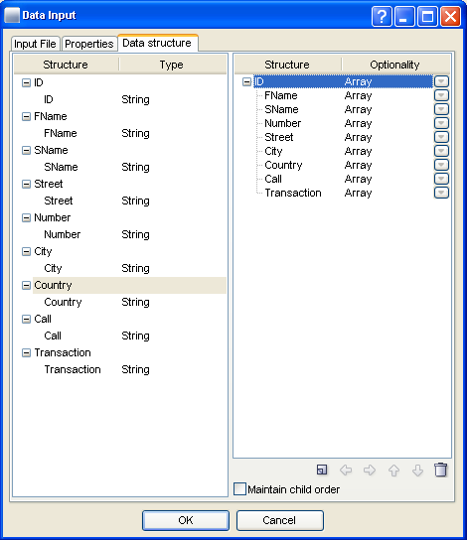
Multiple Record – Data Structure
Use arrows to set data structure
Notes:
Once all variables have been included in the data structure, use the arrow icons to define the structure itself. This is how the structure will appear in the Layout tree.
Notice the difference in structure between the two screenshots.
Array – You can set your variables so that if they exist in the data input file, they will enter the Layout as arrays. If you create your variable as an array, you will also create an Index system variable for that array.
Must Exist – You can set your variables so that they must exist in the data input file, otherwise an error message will be displayed.
Optional – You can set your variables so that they can exist or not exist. If a variable is set as optional, and it does exist in the data input file, then an Exists system variable will be created.

Slide 39
Multiple Record Type – Data Proof
Notes:
Drag and drop a Layout module into the PrintNet T work space and connect it to the Data Input module.
Select Workflow|Run Proof or press <F6>.

Slide 40
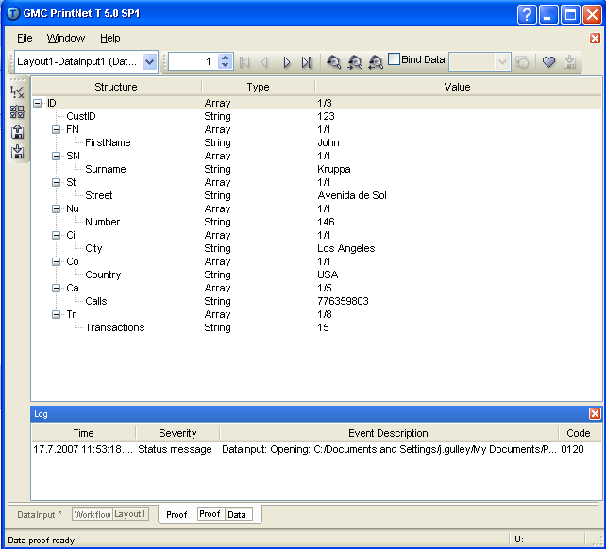
Multiple Record – Data Proof

Slide 41
Multiple Record Type – Exercise
Use a .TXT file as a Multiple Record Type Data Input.
  Create a new workflow.
  Place a Data Input and Layout module into the workflow.
  Open Data Input.
  Load MRecTypeN.txt as the Input file (from the Data Input directory).
  Set all options correctly (text qualifiers, text encoding, etc.).
  Map input data to the following fields: ID, Name, Surname, Street, Number, City, Country, Calls, Transaction.
  Set proper data structure.
  Proof the job; use Data Proof to see data structure.

Slide 42
5. DBF

Slide 43
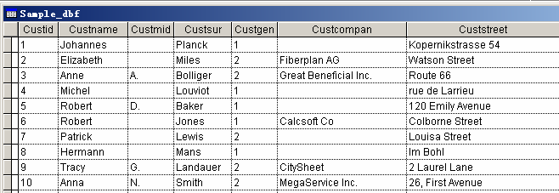
DBF – Data File Example
DBF – Database File Format
Data preview in Visual FoxPro
Notes:
DBF is a Microsoft Access File type.
ODBC Data Input modules can input DBF file types as well; when a DBF enters a workflow via ODBC Data Input, its variables will be of the type “Double”; via Data Input, variables are “String” type.
Field Definition:
Records in DBF.

Slide 44
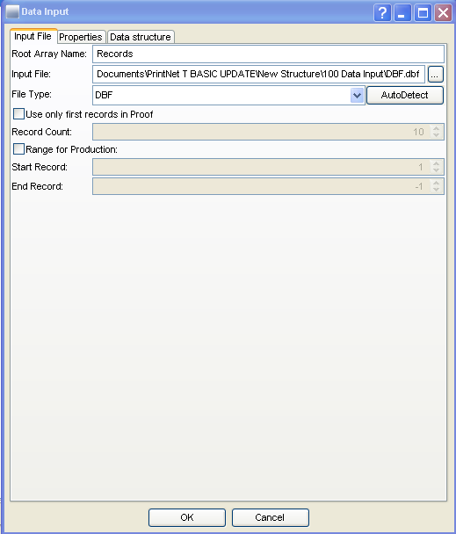
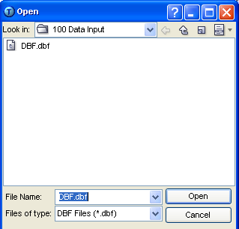
DBF – Input File Tab

Slide 45
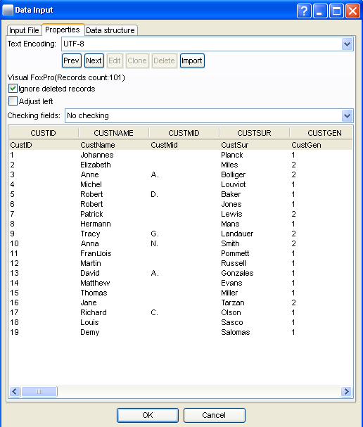
DBF – Properties Tab
Total record number
Parameters for pre-processing
Data structure loaded automatically for preview

Slide 46
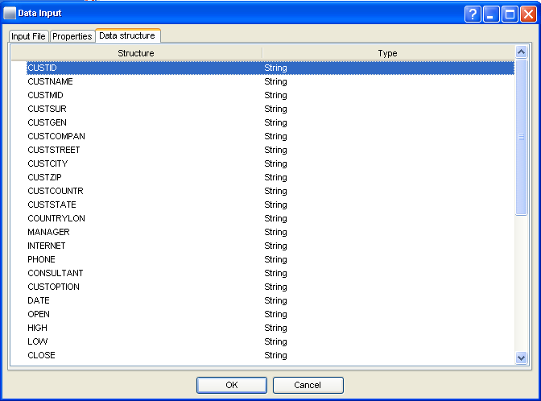
DBF – Data Structure Tab

Slide 47
DBF – Data Proof
Notes:
Drag and drop a Layout module into the PrintNet T work space and connect it to the Data Input module.
Select Workflow|Run Proof or press <F6>.

Slide 48
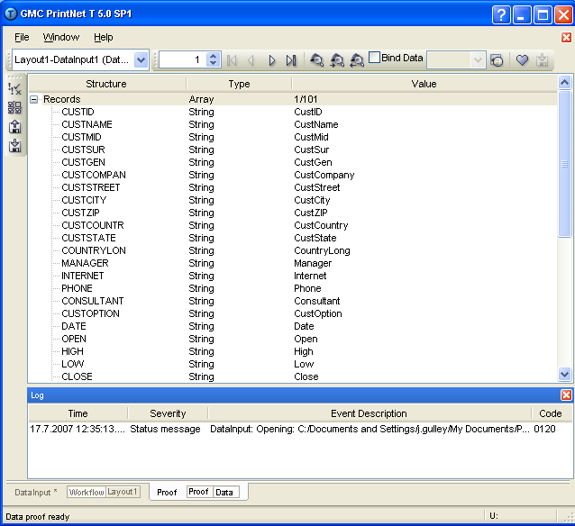
DBF – Data Proof

Slide 49

Data Input – Discussion
What data types are supported by the Data Input module?
What is the best way of checking your data structure and records?
What is text encoding and why is it important?
Notes:
1. What data types are supported by the Data Input module?
CSV, Fixed Length, DBF, CustCode
What is the best way of checking your data structure and records?
Data Proof <F6>
What is text encoding and why is it important?
Text encoding is a collection of special computer codes that recognize different texts from around the world. Because not all languages use the same alphabets, there have been different text encodings used. PrintNet T supports a large number of these encodings, but it is up to the user to choose the proper one.

Slide 50

Thank You.
Do You Have Any Questions?

